Slide 1
MicroFluidic Flow Control
Nikhil Ranjan
Dishant Pandya
Shachi Vaman Khadilkar
Ashley Antony Gomez

Slide 2
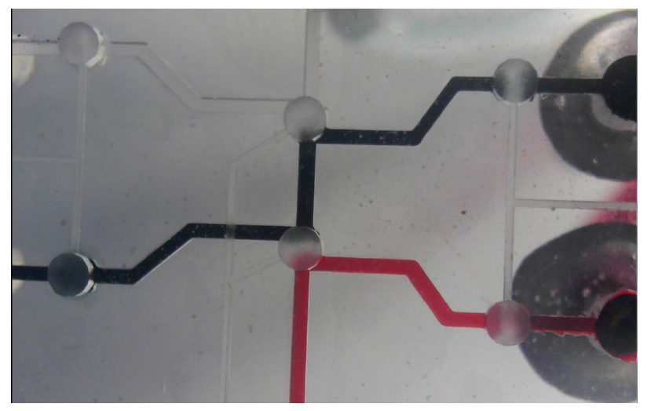
Goal
Creating an Optimization/debugging tool for microfluidic experiments
Control is defined by a set of instructions.
Example - Transformation Chip
Picture Courtesy:- http://2017.igem.org/Team:BostonU_HW/Transformation
Notes:
To create a system that can help microfluidic designers to control valves on a chip.
To use this device for example to carry out the transformation experiment.
Get the chip assembled.
Connect FPGA controlled syringe pumps for control valves (One for each valve)
Connect other syringe pumps for flow implementation.
Connect tubings filled with liquids.
Start FPGA and open control 1. Then control 2. Then fill liquids, then close valve 1 & 2. Then Open valve 2 for some more oil for mixing. Then close it. Then open valve 3. Collect Output. Experiment Done.

Slide 3
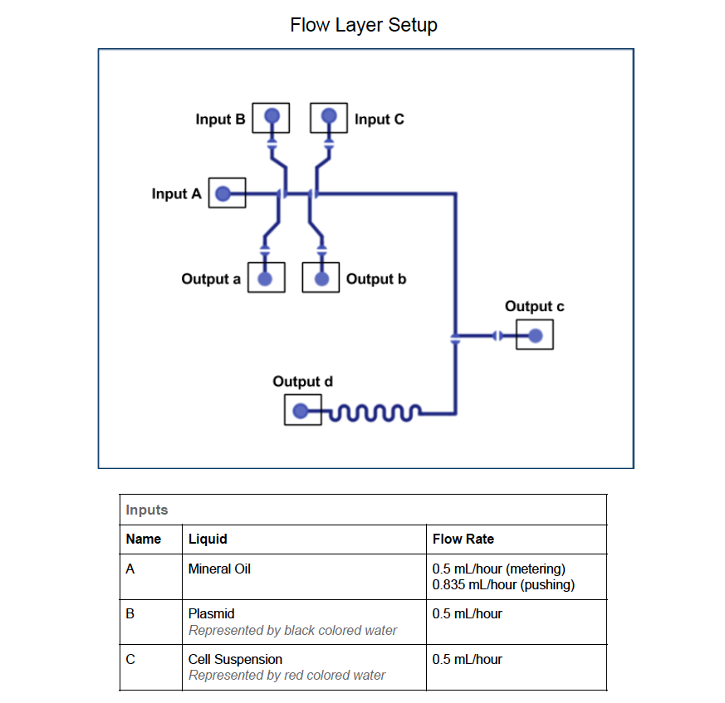
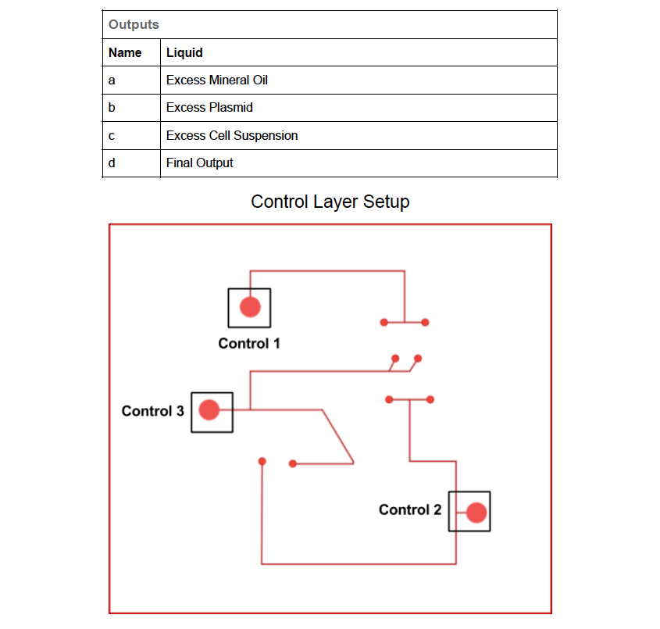
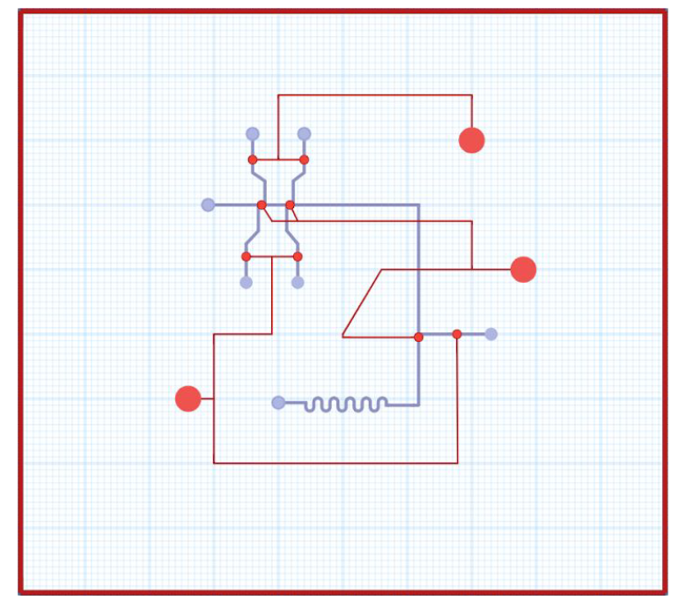
High level overview -Transformation
Picture Courtesy:- http://2017.igem.org/Team:BostonU_HW/Transformation
Notes:
This microfluidic chip is designed to perform transformation. Suspended cells and plasmid are metered on the chip and are then mixed together The solution then undergoes heat shock in a time dependent mixing element for exactly 30 seconds The solution can then be pipetted out from the chip into a recovery tube on ice.
Control through FPGA controlled syringe pumps. Flow of liquids through other syringe pumps.
Open control 1 to allow flow of plasmids and cells.
Open control 2 to allow flow of mineral oil which will be acting as a carrier for the cells as well as plasmids.
Begin flow of these liquids using the syringes at a specified flow rate.
Fill up to metered limit.
Close valves 1 & 2 with an intermediate delay between closing of these 2.
Open control 3. Flow the mineral oil again for mixing.
Collect the output then close valve 3.
Flush everything out post experiment.

Slide 4
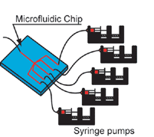
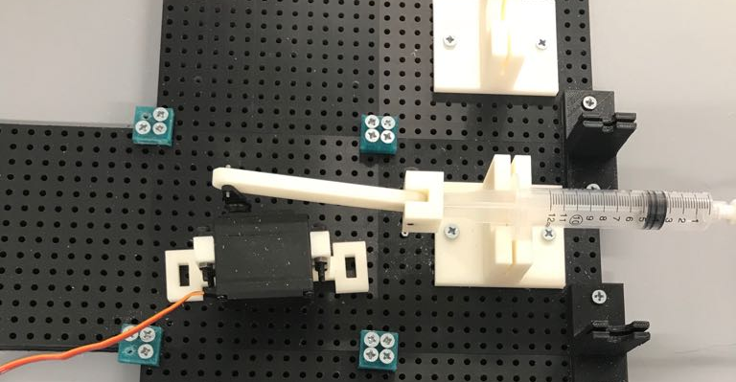
High level overview
Motor controlled syringe pumps .

Slide 5
Overview specification
Control the syringe pumps that actuate the valves using simple instruction.
Number of valves to control on the transformation chip : 3
Maximum delay : 20 days.
Minimum delay : 1 millisecond.
Manual debugging can be done using 2 potentiometer knobs.

Slide 6
Functionality
FPGA
Motor
Syringes
1.Set V1 -1
2.Delay -10s
3.Set V1-0
4.Set V2-1
5.Delay -10s
Notes:
Milliliters per hour
Main modules
Counter
XADC
PWM
Microarchitecture as a whole

Slide 7
Detailed Functionality
Instruction set:
Set Instruction
Example of instructions for the transformation chip:
set valve 1 open
set valve 2 open
delay for 500 millisecond (debug = 0)
set valve 1 close
set valve 2 close
set valve 3 open
delay for 500 millisecond (debug =0)
set valve 3 close
halt
Opcode
Valve
Don’t Care
Set Bit
Set
0 | 0 | 1 | 0 | 0 | 0 | 1 | 0 | 0 | 0 | 0 | 0 | 0 | 0 | 0 | 0 | 0 | 0 | 0 | 0 | 1
Delay Instruction
Opcode
Don’t Care
Delay Time
Unit of time
Debug
0 | 1 | 0 | 0 | 0 | 0 | 1 | 0 | 0 | 0 | 0 | 0 | 0 | 1 | 0 | 1 | 0 | 0 | 0 | 0 | 1
Halt
Opcode
Don’t Care
0 | 0 | 0 | 0 | 0 | 0 | 0 | 0 | 0 | 0 | 0 | 0 | 0 | 0 | 0 | 0 | 0 | 0 | 0 | 0 | 0
Notes:
Counter will decide the opening time of control valves.
PWM will control the opening rate of control valves
XADC will allow for manual addition of opening/closing time of valves

Slide 8
Detailed functionality (For one valve)
Stall
Counter
1
ADD
Delay Time
Decode
Ins[0]
PC
Instruction Memory
Debug
Manual delay
0
2:1
MUX
PWM
Motor
XADC
Status Registers
Knob1
Encoder
Knob2
Notes:
Counter go to pc when done to resume and go to next instruction.

Slide 9
Verilog example
Unique necessity for a days counter
We implemented without using a single huge milliseconds counter.
Notes:
XADC as the most proud of.
Counter as the novel one that can count up to twenty days without using huge counters.

Slide 10
always@(posedge clk)
begin
case(delay_unit)
3'b000:
begin
if(msec_count == delay) begin
rst_flag <= 1;
count_flag <= 1;
end
end
3'b001:
begin
if(sec_count == delay) begin
rst_flag <= 1;
count_flag <= 1;
end
end
3'b010:
begin
if(min_count == delay) begin
rst_flag <= 1;
count_flag <= 1;
end
end
3'b011:
begin
if(hour_count == delay) begin
rst_flag <= 1;
count_flag <= 1;
end
end
3'b100:
begin
if(day_count == delay) begin
rst_flag <= 1;
count_flag <= 1;
end
end
endcase
if ((debug_flag == 0) && (count_flag == 1))
count_done <= 1;
else if ((debug_flag == 1) && (count_flag == 1))
begin
debug_count <= 0;
if(debug_count < manual_delay)
debug_count <= debug_count + 1;
else
begin
debug_count <= 0;
count_done <= 1;
end
end
if(hour_flag == 1) begin
if ((hour_count < 5'b11000)&&(hour_flag == 1)) begin
hour_count <= hour_count + 1;
min_count <= 0;
day_flag <= 0;
hour_flag <= 0;
msec_count <= 0;
sec_count <= 0;
end
else
begin
day_flag <= 1;
end
end

Slide 11
Successes
XADC interfacing.
Created a counter module for the delays.
Created a processor that can control the motors of the valve syringes based on a simple instruction set.
A PWM module to control the motor.

Slide 12
failures
Manual control using knobs still not implemented.
No data logging.
Reduced the number of knobs that can be used to give manual delay from 4 to 2.
Tried implementing motor control using a level shifter.
Notes:
Servo torque insufficient.

Slide 13
Design tradeoffs
Removed the resource constraint from knobs so that number of knobs needn’t be equal to the number of valves.
Removed individual counters from the PWM.
Implemented a single counter for delays that range from milliseconds up-to days.

Slide 14
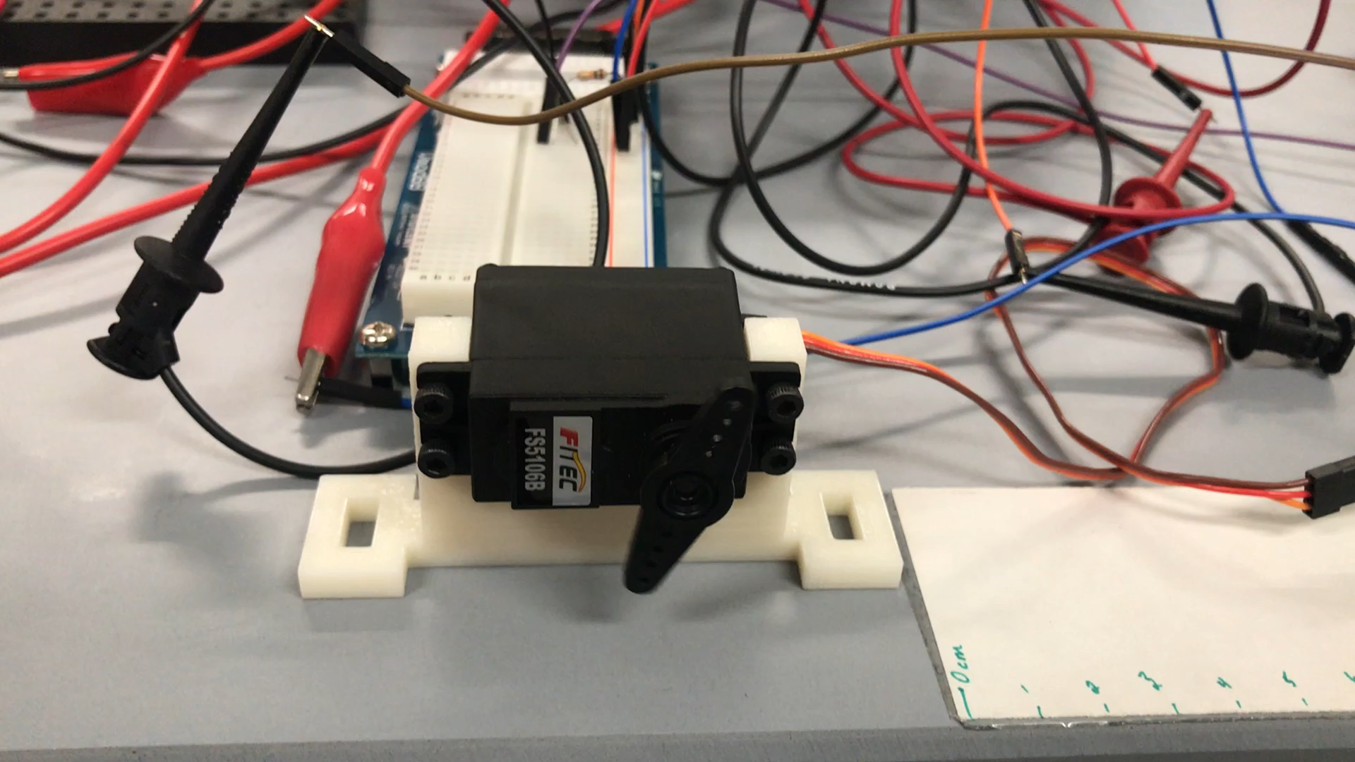
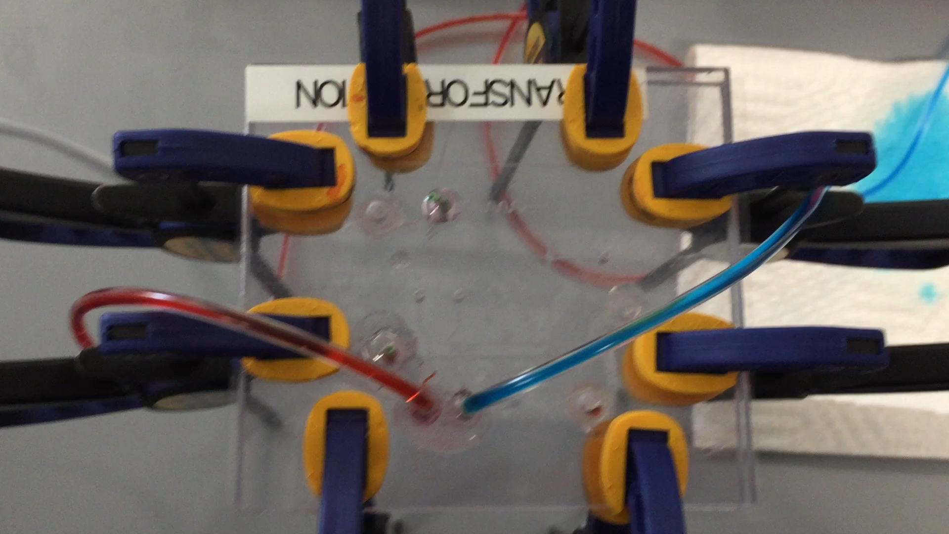
Video

Slide 15
Work distribution
Nikhil – Microfluidic integration
Dishant – PWM and XADC interfacing
Shachi – UART interfacing and processor
Ashley – XADC interfacing and processor

Slide 16
Thank You

Slide 17
Appendix

Slide 18
High level overview of the Functionality
Instructions
Instruction parsing
FPGA
PWM
Motor
Syringe Pumps
ADC
Encoder
Analog Signals
Knobs
Notes:
. Take instructions from the user to control valves and give delays between states.

Slide 19
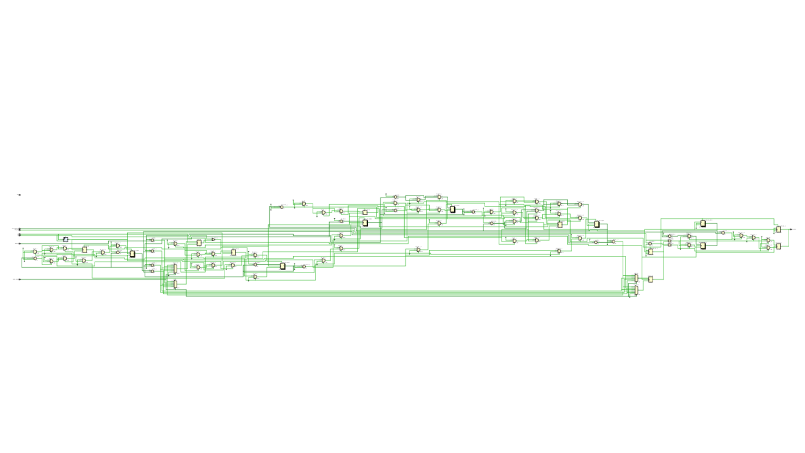
RTL of the counter

